Slide 1
Titanic Survivor Prediction
Using Random Forest Classifier
Presented By:
Mr.Aditya Viswabhusan
Mr.Ashutosh Kar
Submitted To:
ICT Cell
IIT Kanpur

Slide 2
INTRODUCTION
The sinking of the RMS Titanic is one of the most infamous shipwrecks in history.
In this project, we were asked to analyse what sorts of people were likely to survive in the disaster.
The project was completed by applying different tools of machine learning to predict which passengers survived the tragedy.
Before feeding on the data to our machine learning model, different pre-processing techniques were applied.
Once the data was ready, different machine learning models were tried upon to find the best accuracy.

Slide 3
Goals And Objective:
Purpose of the Project is to generate predictions for Titanic Passengers.
Objective of the Project is to build a Classification model and determine whether a passenger has survived or not.

Slide 4
Software Required:
Python v3.8
Anaconda Navigator v1.9.12
Jupyter Notebook v6.0.3
Libraries Used:
Pandas
Numpy
Scikit Learn

Slide 5
Random Forest Classifier
Random Forest Classifier is a set of decision trees from randomly selected subset of training set. It aggregates the votes from different decision trees to decide the final class of the test object.
It runs efficiently on large databases and produces highly accurate classifier
It generates an internal unbiased estimate of the generalization error as the forest building progresses.
It has an effective method for estimating missing data and maintains accuracy when a large proportion of the data are missing.

Slide 6
Implementation:
Importing necessary libraries.
Importing the datasets.
Cleaning and Analyzing the dataset
Building the model.
Using Random Forest for making the prediction.

Slide 7
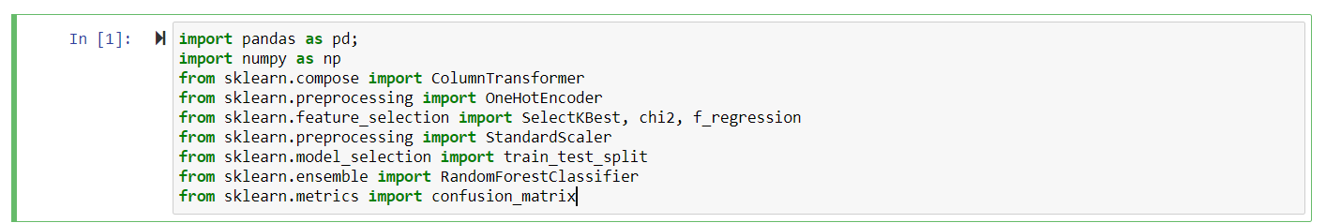
Importing Necessary Libraries:

Slide 8
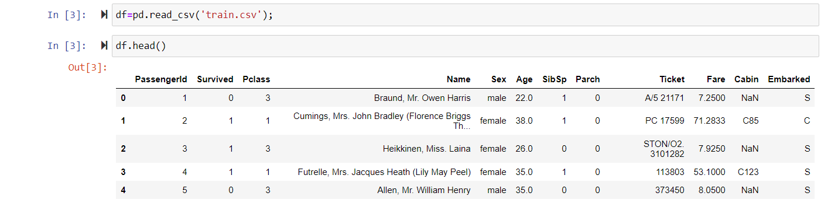
Reading The Data from dataset:

Slide 9
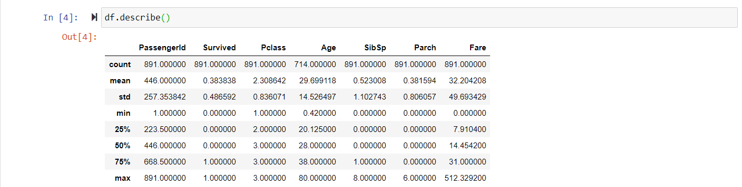
Analyzing the Data:

Slide 10
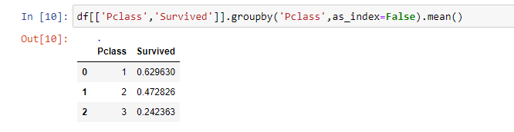
Pclass Vs. Survived
The passengers having Pclass as 1,2 had higher Survival rate.

Slide 11
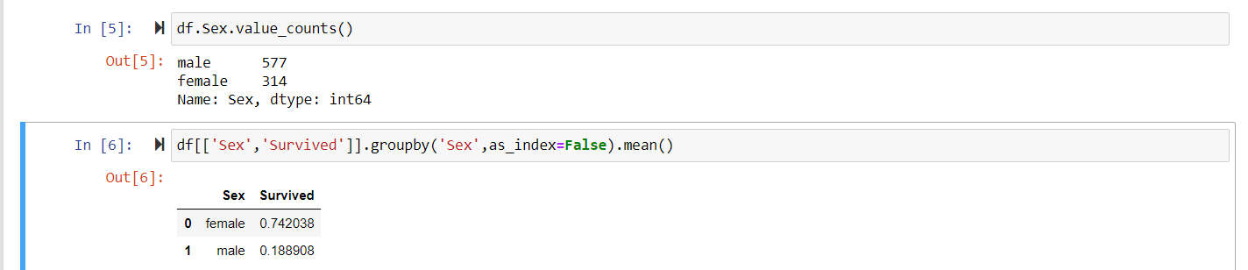
Sex vs. Survived:
The Female passengers had a higher rate of survival.

Slide 12
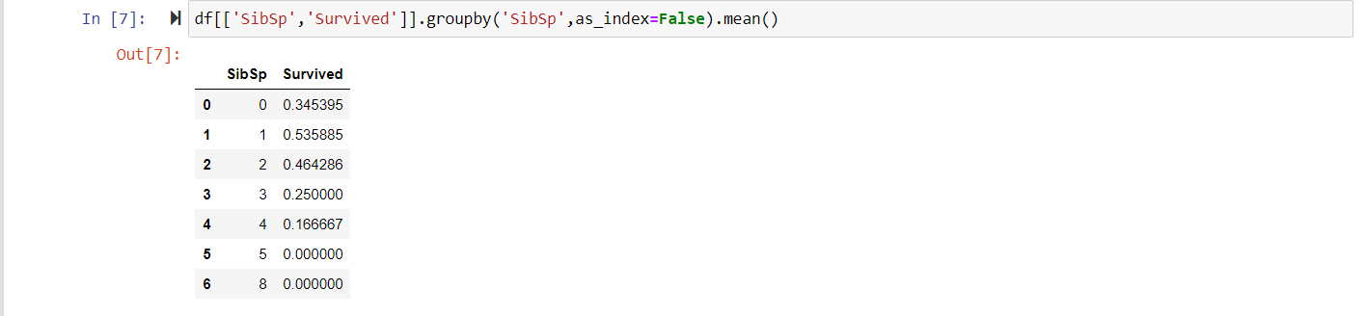
SibSp vs. Survived
The passenger having less SibSp had higher rate of survival.

Slide 13
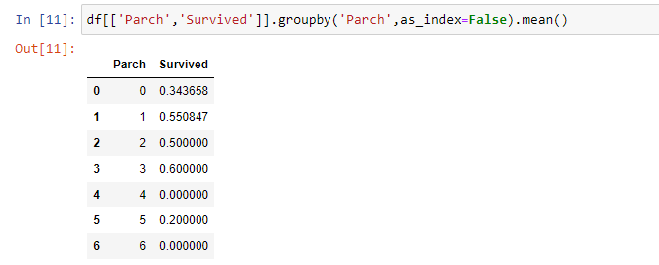
Parch Vs. Survived
The passengers having Parch as 1,2,3 had a higher rate of Survival.

Slide 14
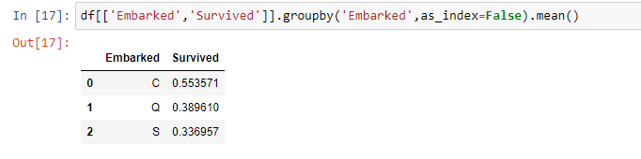
Embarked Vs. Survived
The passengers Embarked from ‘C’ had a higher rate of Survival.

Slide 15
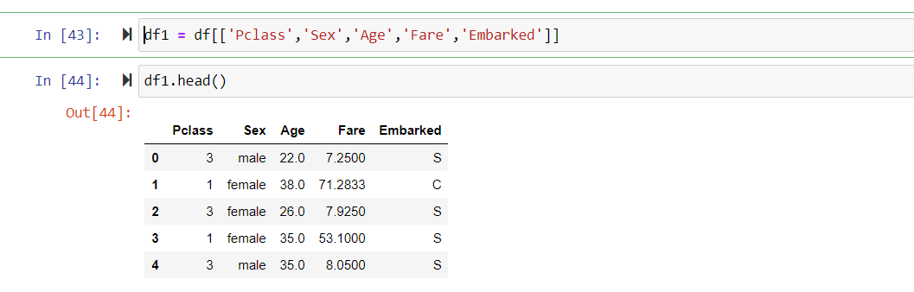
Findings:
From the above analysis , we determine that ‘Pclass’ , ‘Sex’, ‘Age’, ‘Fare’ , ‘Embarked’ majorly determine the survival outcome.

Slide 16
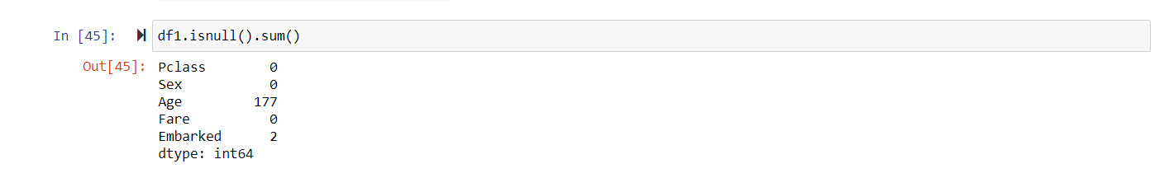
Finding the NULL values in our dataset:
The Null values found in the dataset were majorly from two classes i.e. Age and Embarked
The Age had 177 Null values and the Embarked had 2 Null values.

Slide 17
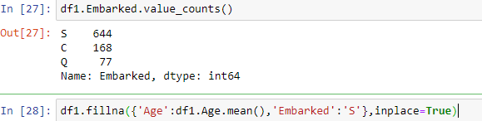
Filling up the NULL values:
The Embarked feature was substituted with ‘S’ as many passengers had embarked from ‘S’.
The Age was substituted with the mean value.

Slide 18
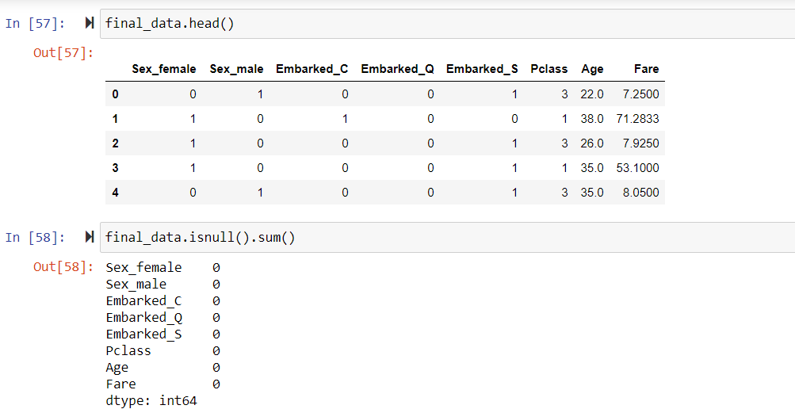
Final Attributes Considered:
The final attributes considered were : ‘Sex’, ‘Pclass’, ‘Age’, ‘Fare’ and ‘Embarked’
Encoding was done on ‘Sex’ and ‘Embarked’ attributes.

Slide 19
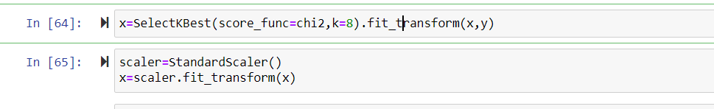
Selecting The K-Best Features and Scaling the data:
To select the best features, SelectKBest method was used.
To scale the data, Standard scaler was implemented.

Slide 20
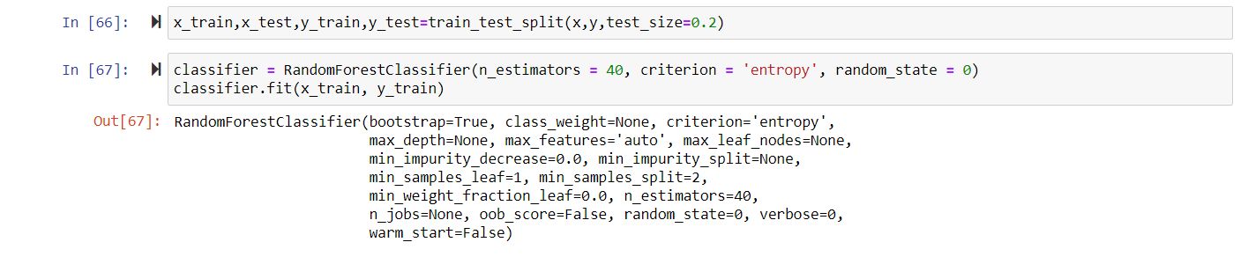
Building The Model:
The train size is considered to be 80% and the test size is considered to be 20%.
n_estimators were fixed at 40.

Slide 21
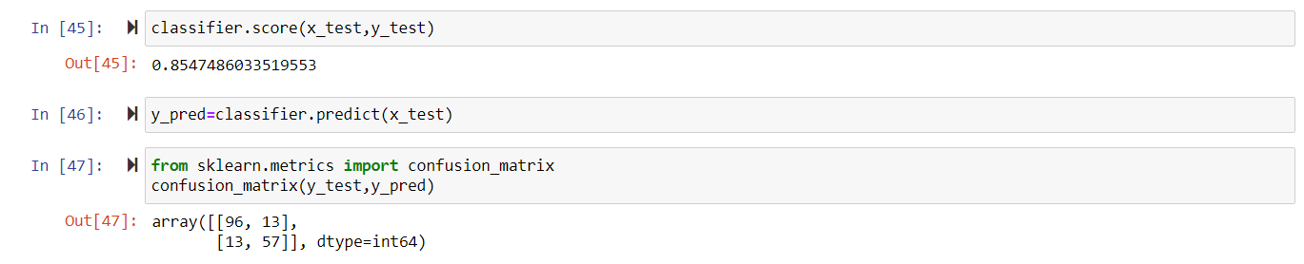
Accuracy Score and Confusion Matrix:
Accuracy was found to be 85.47% for the following prediction

Slide 22
Conclusion:
All previous classifications model gave accuracy which was less than 82.00%.
No algorithm was able to give accuracy of 100.00%.
Certain attributes like ‘PassengerId’, ’Ticket’, ’Cabin’, ‘Name’, ‘SibSp’, ‘Parch’ were not considered as they were not much affecting the target variable.
From the analysis we found that Women,Children and First Class Passengers had a higher chance of survival, as compared to others.

Slide 23
Thank You !

